Slide 1
Structures, Unions and Enumeration
Mr. Said Nabi

Slide 2
Abstract Data Type/ User Defined Data Type
You have seen many primitive data types like int, float, double, bool etc.
An abstract data type (ADT) is a data type created by the programmer and is composed of one or more primitive data types.

Slide 3
Abstract Data Type
So far you’ve written programs that keep data in individual variables.
If you need to group items together, C++ allows you to create arrays.
The limitation of arrays, however, is that all the elements must be of the same data type.
Sometimes a relationship exists between items of different types of elements.

Slide 4
Abstract Data Type
Their definition statements do not make it clear that they belong together.
Variable Definition | Data Held
int empNumber; | Employee number
string name; | Employee’s name
double hours; | Hours worked
double payRate; | Hourly pay rate
All these variables hold data about the same employee

Slide 5
Combining Data into Structures
Structure: is a user-defined data type. It is like a container that allows multiple variables to be grouped together. Structures are used to organize related data (variables) into a nice neat package.
Variables can be of any type
  struct structName
  {
  dataType field1;
  dataType field2;
  . . .
  };

Slide 6
Introducing Structures
A structure is a collection and is referenced with single name.
The data items in structure are called structure members, elements, or fields.
The difference between array and structure: is that array must consists of a set of values of same data type but on the other hand, structure may consist of different data types

Slide 7
Example struct Declaration
  struct Student
  {
  int studentID;
  string name;
  short yearInSchool;
  double gpa;
  };
  Organize related data (variables) into a nice neat package (single unit)
structure name
structure members

Slide 8
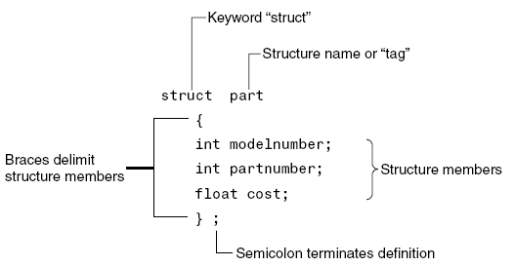
Structure Definition Syntax

Slide 9
struct Declaration Notes
Made in global scope usually, so can access the user-defined datatype in all functions
Must have ; after closing }
struct names commonly begin with uppercase letter
Multiple fields of same type can be in comma-separated list:
  string name, address;

Slide 10
Creating struct Variables
struct declaration does not allocate memory or create variables
Must create a struct variable
To create variables, use structure name as type name
Student tom;
tom
studentID
name
structure name
variable name
yearInSchool
gpa

Slide 11
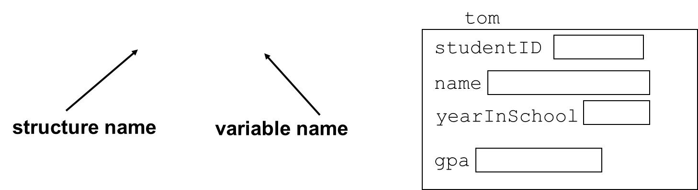
Creating struct Variables
Must declare a structure before creating a structure variable
Student tom;

Slide 12
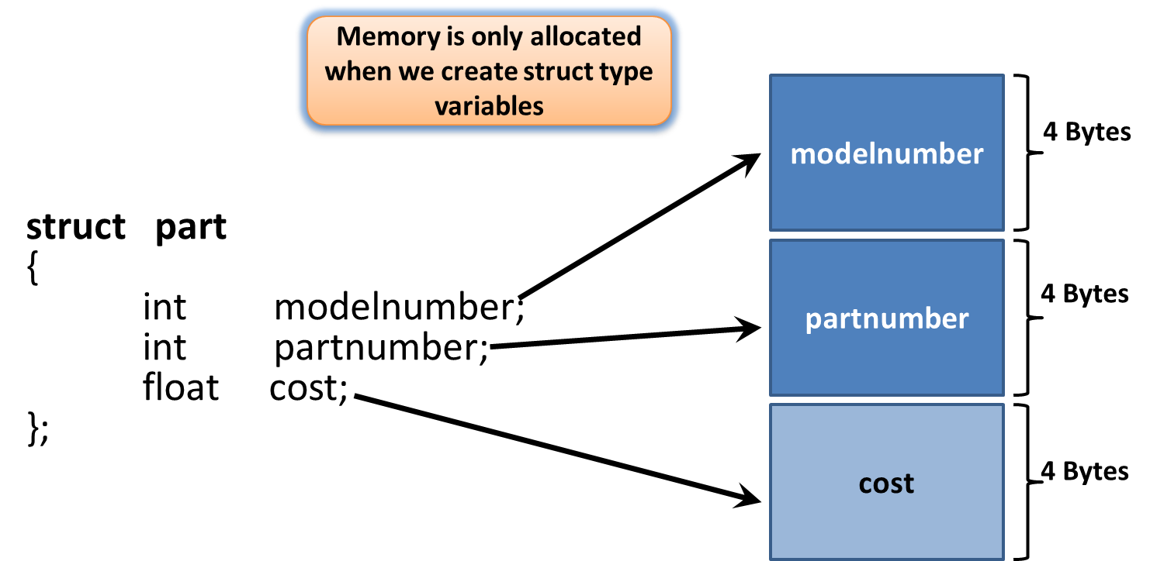
Structure Members In Memory

Slide 13
Creating struct Variables – Another way
Can also create a structure variable with its declaration
  struct Student
  { int studentID;
  string name;
  short yearInSchool;
  double gpa;
  } student1;

Slide 14
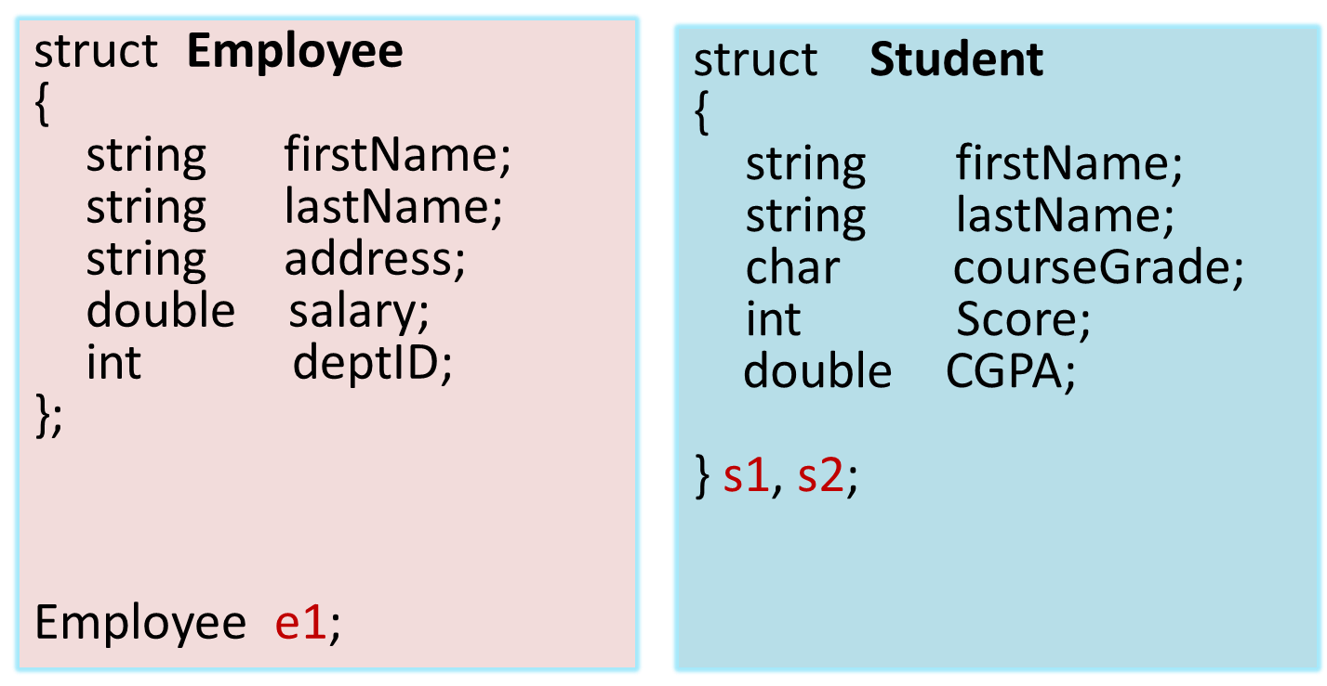
Creating struct Variables Two Ways

Slide 15
Initializing a Structure
The syntax of initializing structure is:
StructName struct_identifier = {Value1, Value2, …};

Slide 16
Initializing a Structure
  Values should be in the same sequence as the structure
  struct Student
  { int studentID;
  string name;
  short yearInSchool;
  double gpa;
  };
struct variable can be initialized when created
  Student s1 = {11465, "Joan", 2, 3.75};

Slide 17
Accessing Structure Members
Use the dot (.) operator to refer to members of struct variables:
  cin >> s1.studentID;
  s1.name = “Alex Stone”;
  s1.gpa = 3.75;
Member variables can be used in any manner appropriate for their data type

Slide 18
Assigning Values to Structure Variables
After creating structure variable, values to structure members can be assigned using cin
Output to screen using cout
student s1;
cin>>s1.firstName;
cin>>s1.lastName;
cin>>s1.courseGrade;
cin>>s1.marks ;
cout<<s1.firstName<<s1.lastName;

Slide 19
More on Initializing a Structure
May initialize only some members:
  Student s1 = {14579};
Cannot skip over members:
// illegal
  Student s1 = {1234, "John", , 2.83};

Slide 20
More on Initializing a Structure
You can also give default values inside a struct definition
  struct Student
  {
  int studentID = 0;
  string name = ““;
  short yearInSchool = 1;
  double gpa = 1.0;
  };

Slide 21
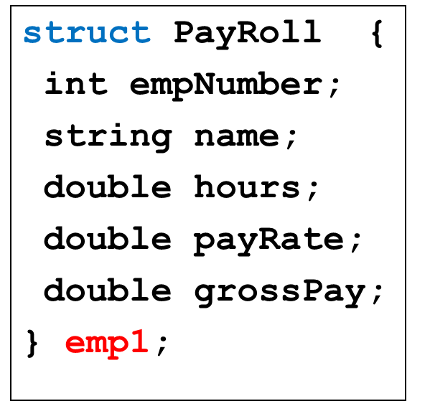
Accessing Structure Members
void main{
emp1.empNumber = 489;
emp1.name = “Jill Smith”;
emp1.hours = 23;
emp1.payRate = 20;
emp1.grossPay = emp1.hours * emp1.payRate;
}

Slide 22
Assigning one Structure Variable to another
structure variable can be assigned to another structure variable only if both are of same type
A structure variable can be initialized by assigning another structure variable to it by using the assignment operator as follows:
Example:
studentType Student1 = {“Amir”, “Ali”, ‘A’, 98} ;
studentType student2 = Student1;

Slide 23
Comparing struct Variables
Cannot compare struct variables directly:
  if (s1 == s2) // won’t work
Instead, must compare on a field basis:
  if (s1.studentID == s2.studentID)

Slide 24
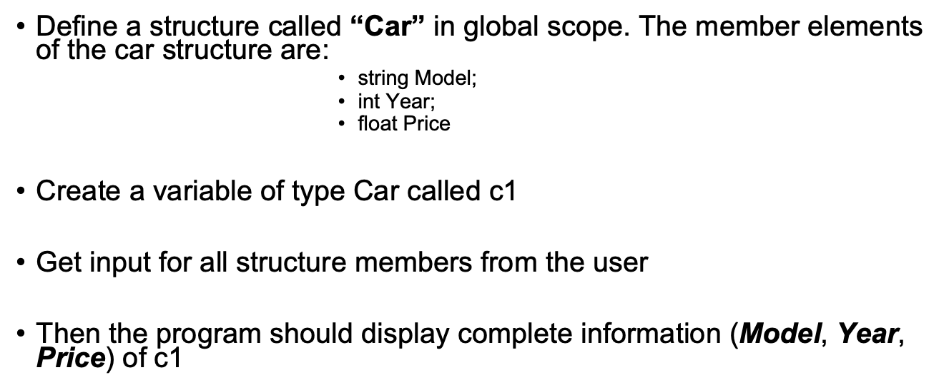
Practice Question

Slide 25
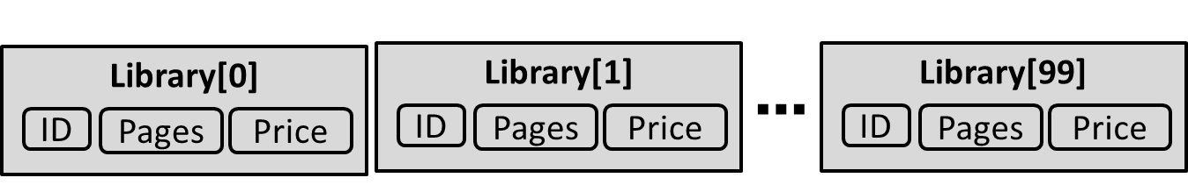
Array of Structures
An array of structures is a type of array in which each array element is a structure
struct Book
{ int ID;
int Pages;
float Price;
};
Book Library[100]; // declare array of structures

Slide 26
Initialization of Array of Structures
Can be used in place of parallel arrays
struct Book
{
int ID;
int Pages;
float Price;
};
Book b[3]; // declaration of array of structures

Slide 27
Initialization of Array of Structures
Initializing can be at the time of declaration
Book b[3] = {{1,275,70},{2,600,90},{3,786,100}};
Or can be assigned values using cin:
cin>>b[0].ID ;
cin>>b[0].Pages;
cin>>b[0].Price;

Slide 28
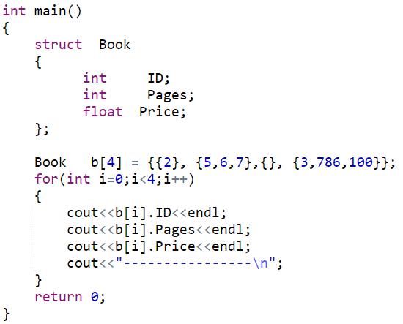
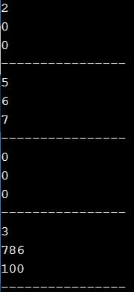
Partial Initialization of Array of Structures

Slide 29
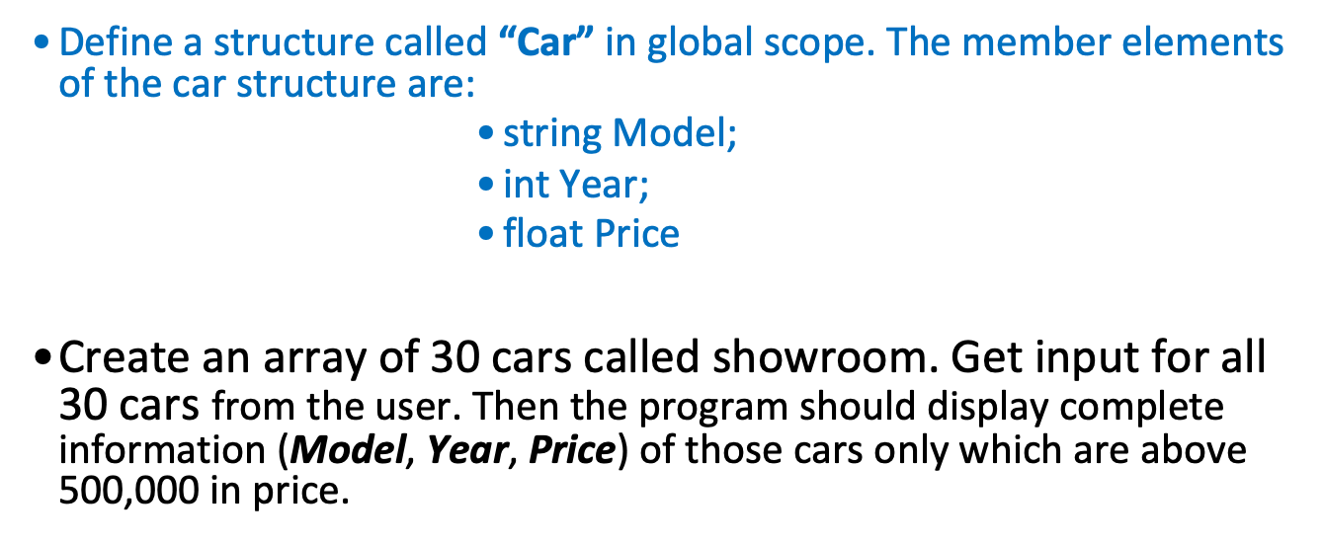
Practice Question

Slide 30
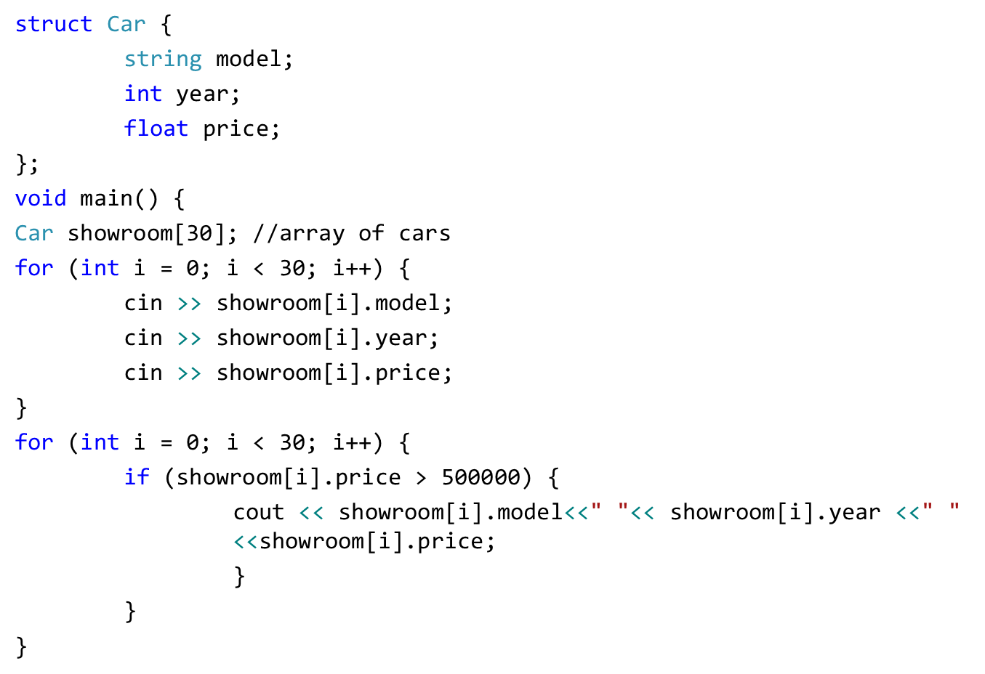
Practice Question

Slide 31
Array as Member of Structures
A structure may also contain arrays as members.
struct Student
{
int RollNo;
float Marks[3];
};
Initialization can be done at time of declaration:
Student S = {1, {70.0, 90.0, 97.0} };

Slide 32
Array as Member of Structures
Can also assigned values later in the program:
Student s1;
s1.RollNo = 1;
s1.Marks[0] = 70.0;
s1.Marks[1] = 90.0;
s1.Marks[2] = 97.0;
Or user can use cin to get input directly:
cin >> s1.RollNo;
cin >> s1.Marks[0];
cin >> s1.Marks[1];
cin >> s1.Marks[2];

Slide 33
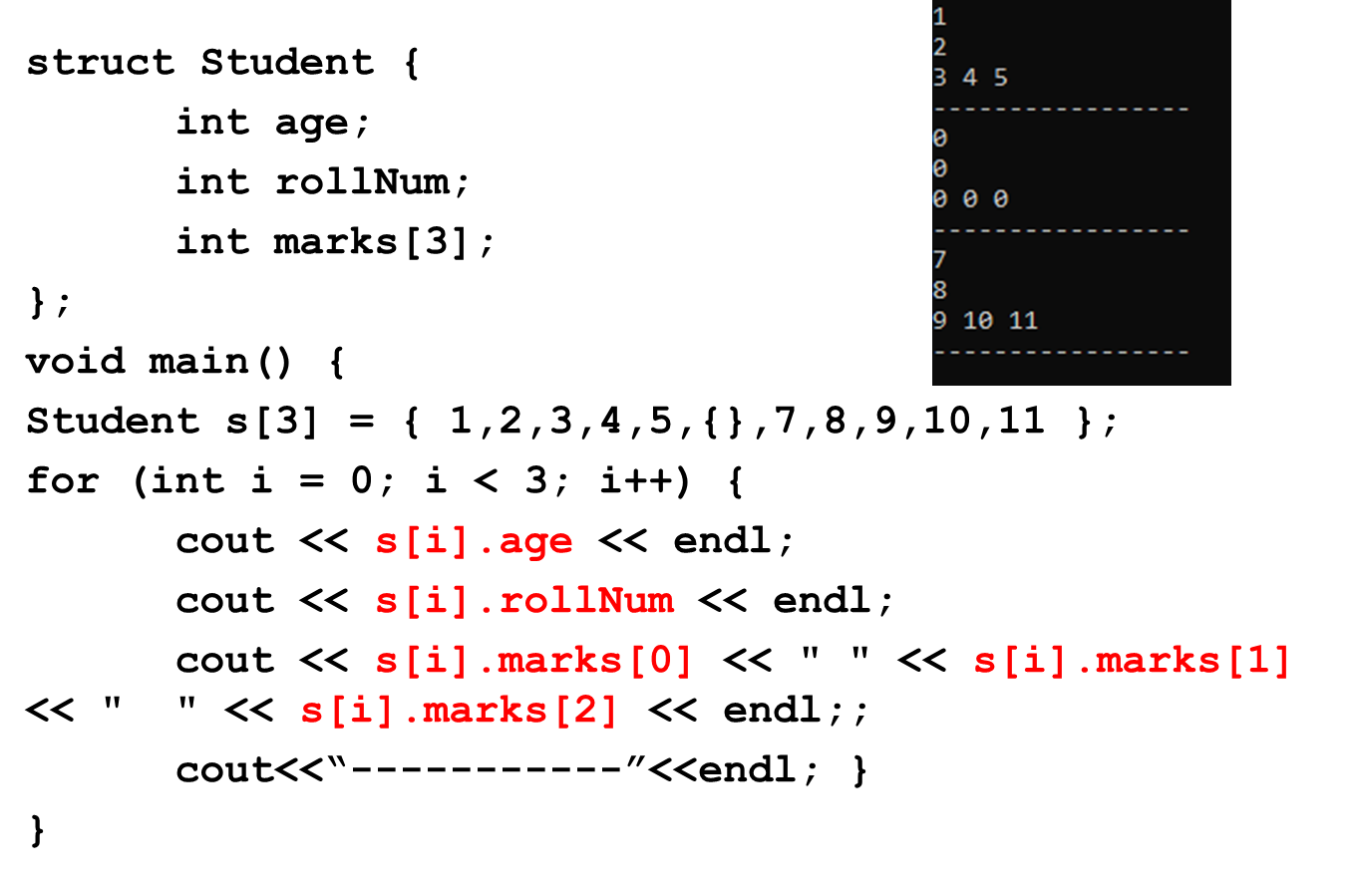
Array as Member of Structures

Slide 34
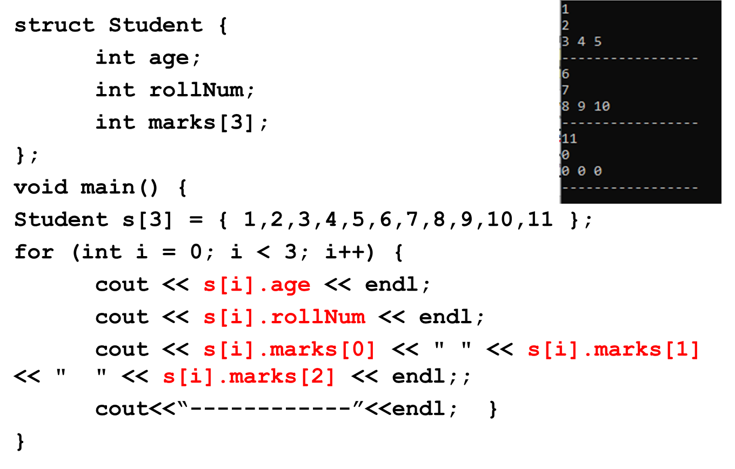
Array as Member of Structures

Slide 35
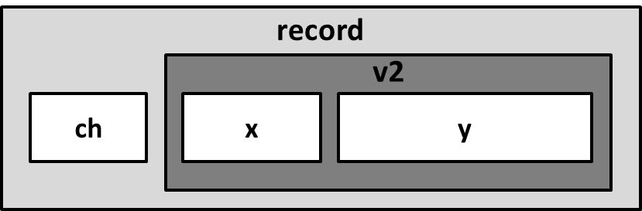
Nested Structure
A structure variable can be a member of another structure: called nested structure
struct A
{
int x;
double y;
};
struct B
{
char ch;
A v2;
};
B record;

Slide 36
Initializing/Assigning to a Nested Structure
struct A{
int x;
float y;
};
struct B{
char ch;
A v2;
};
void main() // Input
{
B record;
cin>>record.ch;
cin>>record.v2.x;
cin>>record.v2.y;
}
void main() // Assignment
{
B record;
record.ch = ‘S’;
record.v2.x = 100;
record.v2.y = 3.6;
}
void main() // Initialization
{
B record = {‘S’, {100, 3.6} };
}

Slide 37
Practice Question
Write a program that implements the following using C++ struct. The program should finally displays contact_Info values for 10 people
Contact_Info
Name
Phone_No
Address
City
Country

Slide 38
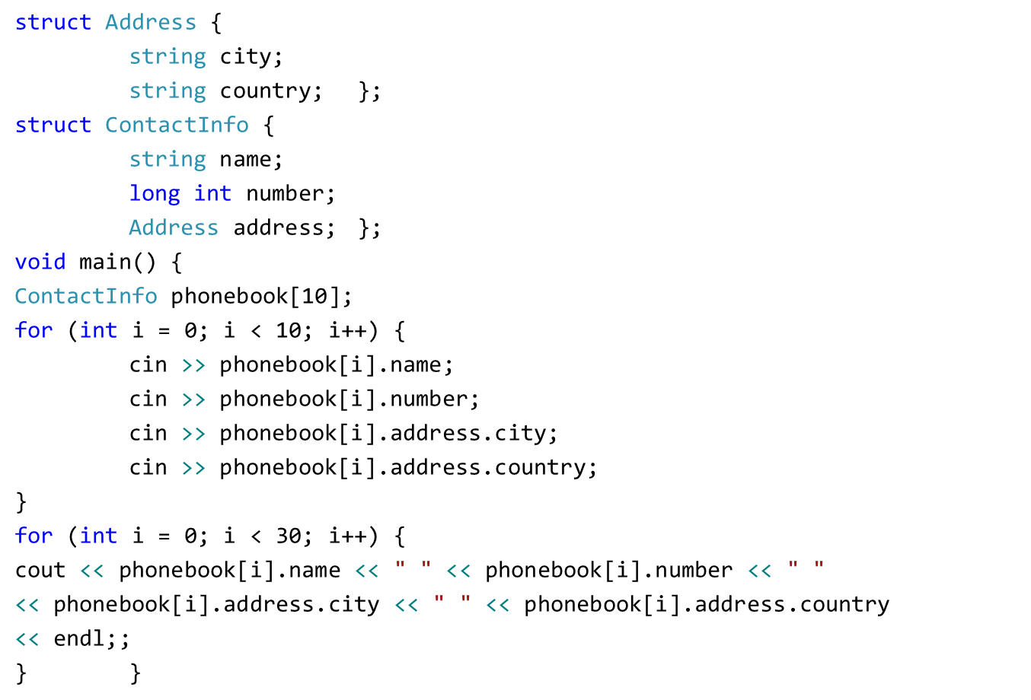
Practice Question

Slide 39
Pointers to Structures
A structure variable has an address
Pointers can be used to point to structure variables.
Pointers to structures are variables that can hold the address of a structure
  Student *stuPtr;
The stuPtr pointer can point at variables of the type Student

Slide 40
Accessing Structures with Pointers
The pointer variable should be of the type:
Your Structure
struct Rectangle {
int width;
int height;
};
void main( )
{
Rectangle rect1 = {22,33};
Rectangle* rect1Ptr = &rect1;
}

Slide 41
Accessing Structures with Pointers
How to access the structure members (using pointer)?
  Use dereferencing operator (*) with dot operator (.)
struct Rectangle {
int width;
int height;
};
void main( )
{
Rectangle rect1 = {22,33};
Rectangle* rect1Ptr = &rect1;
cout<<(*rectPtr1).width << endl;
cout<<(*rectPtr1).height << endl;
}

Slide 42
Accessing Structures with Pointers
Is there some easier way to do this?
  Use arrow operator ( -> ) instead of * and .
struct Rectangle {
int width;
int height;
};
void main( )
{
Rectangle rect1 = {22,33};
Rectangle* rect1Ptr = &rect1;
cout<< rectPtr1->width << endl;
cout<< rectPtr1->height << endl;
}

Slide 43
Dynamic Memory Allocation
The pointer variable can be used to dynamically allocate memory for a structure variable:
struct Rectangle {
int width;
int height;
};
void main( )
{
Rectangle* rect1Ptr = new Rectangle;
rect1Ptr->width=22;
rect1Ptr->height=33;
}

Slide 44
Pointer as Structure Member
Pointers can also be a member of a structure
struct Rectangle {
int *width;
int height;
};
void main( )
{ int w = 3;
Rectangle rect1 = {&w,5}
*rect1.width = 2; //dot has higher precedence
rect1.height = 4;
}
Address of variable w is assigned to the pointer width

Slide 45
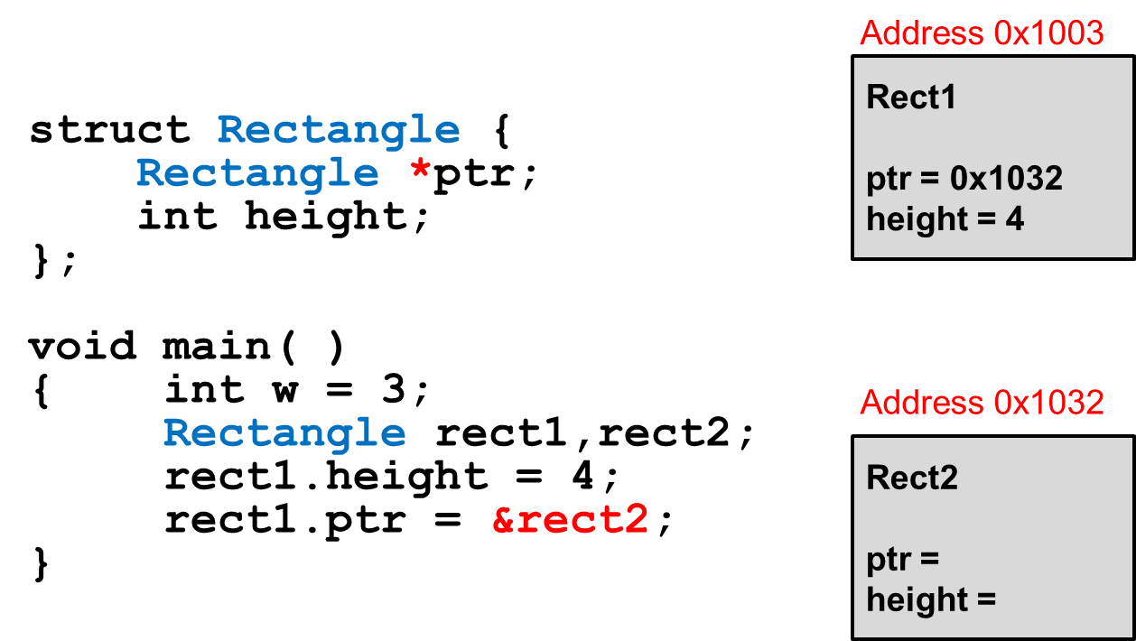
Pointer as Structure Member
Pointers can also be a member of a structure

Slide 46
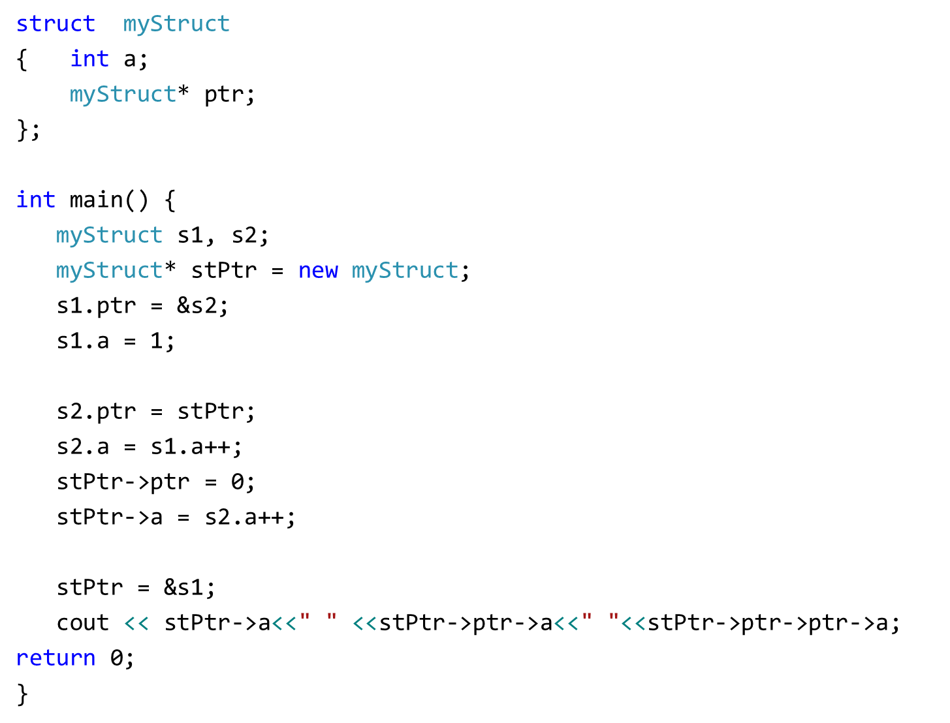
Output: 2 2 1
Post-increment, increments value after assignment

Slide 47
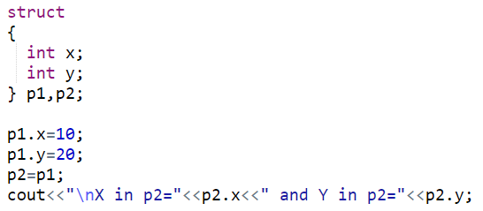
Anonymous Structure
Structures can be anonymous
Must create variable after declaration

Slide 48
Other Stuff You Can Do With a struct
You can also associate functions with a structure (called member functions)

Slide 49
Quick Example
struct StudentRecord {
string name; // student name
int marks[5]; // test grades
double ave; // final average
void print_ave( ) {
cout << "Name: " << name << endl;
cout << "Average: " << ave << endl;
}
};

Slide 50
Using a Member Function
Use the dot operator to call member functions of a struct
StudentRecord stu;
stu.print_ave( );

Slide 51
Structures as Function Arguments
May pass members of struct variables to functions:
  //function definition
  float computeGPA(float gpa){
  ……………
  }
  //function call
  computeGPA(s1.gpa);

Slide 52
Structures as Function Arguments
May pass entire struct variables to functions
  Pass-by-value
  Pass-by-reference
  Pass-using pointers

Slide 53
Structures as Function Arguments – Pass by Value
struct Rectangle {
double length;
double width;
double area;
};
void changeRect(Rectangle r) {
r.length = 5;
r.width = 6;
r.area = 30;
}
void main(){
Rectangle box = {1, 2, 2};
changeRect(box); }
A copy of the struct box is created and saved in the function parameter r

Slide 54
Structures as Function Arguments – Pass by Value
void changeRect(Rectangle r) {
r.length = 5;
r.width = 6;
r.area = 30;
}
void main(){
Rectangle box = {1, 2, 2};
changeRect(box);
cout << box.length << endl; prints 1
cout << box.width << endl; prints 2
cout << box.area << endl; prints 2
}

Slide 55
Structures as Function Arguments – Pass by Reference
The actual struct variable box is passed by reference (parameter r is just another name for box)
struct Rectangle {
double length;
double width;
double area;
};
void changeRect(Rectangle &r) {
r.length = 5;
r.width = 6;
r.area = 30;
}
Rectangle box = {1, 2, 2};
changeRect(box);

Slide 56
Structures as Function Arguments – Pass by Reference
void changeRect(Rectangle &r) {
r.length = 5;
r.width = 6;
r.area = 30;
}
void main(){
Rectangle box = {1, 2, 2};
changeRect(box);
cout << box.length << endl; prints 5
cout << box.width << endl; prints 6
cout << box.area << endl; prints 30
}

Slide 57
Structures as Function Arguments - Notes
Passing a structure to a function by value can slow down a program, waste space
Passing a structure to a function by reference will speed up program, but the function may change data in structure
Using a const reference parameter allows read-only access to reference parameter, it is fast and does not waste space

Slide 58
Structures as Function Arguments – Pass by const Reference
void changeRect(const Rectangle &r) {
r.length = 5;//ERROR! Cannot modify const
r.width = 6; //ERROR! Cannot modify const
r.area = 30; //ERROR! Cannot modify const
}
void main(){
Rectangle box = {1, 2, 2};
changeRect(box);
}

Slide 59
Structures as Function Arguments – Pass by const Reference
void showRect(const Rectangle &r) {
cout << r.length << endl;
cout << r.width << endl;
cout << r.area << endl;
}
void main(){
Rectangle box = {1, 2, 2};
showRect(box);
}
Output: 1
2
2

Slide 60
Returning a Structure from a Function
A Function can return a struct:
  Student getStudentData(); // prototype
  stu1 = getStudentData(); // call
Function must define a local structure variable
  for internal use
  for use with return statement

Slide 61
Returning a Structure from a Function - Example
  Student getStudentData()
  {
  Student tempStu;
  cin >> tempStu.studentID;
  cin >> tempStu.yearInSchool;
  cin >> tempStu.gpa;
  return tempStu;
  }

Slide 62
Structure
A Structure is a container, it can hold a bunch of things.
  These things can be of any type.
Structures are used to organize related data (variables) into a nice neat package.

Slide 63
Example - Student Record
Student Record:
  Name a string
  HW Grades an array of 3 doubles
  Test Grades an array of 2 doubles
  Final Average a double

Slide 64
Structure Members
Each thing in a structure is called member.
Each member has a name, a type and a value.
Names follow the rules for variable names.
Types can be any defined type.

Slide 65
Example Structure Definition
struct StudentRecord {
char *name; // student name
double hw[3]; // homework grades
double test[2]; // test grades
double ave; // final average
};

Slide 66
Using a struct
By defining a structure you create a new data type.
Once a struct is defined, you can create variables of the new type.
StudentRecord stu;

Slide 67
Accessing Members
You can treat the members of a struct just like variables.
You need to use the member access operator '.' (pronounced "dot"):
cout << stu.name << endl;
stu.hw[2] = 82.3;
stu.ave = total/100;

Slide 68

Structure Assignment
You can use structures just like variables:
StudentRecord s1,s2;
s1.name = "Joe Student";
…
s2 = s1;

Slide 69

Be Careful
If a member is a pointer, copying means copying the pointer (not what is pointed to).
"Joe Student"
name
hw
test
ave

Slide 70
Probably not what you want
StudentRecord s1,s2;
s1.name = "Joe Student";
…
s2 = s1;
s2.name = "Jane Doe";
// now s1.name and s2.name are both
// "Jane Doe"

Slide 71
Pointers to Structures
Pointers to structures are used often.
There is another member access operator used with pointers: ->
  StudentRecord *sptr;
  …
  cout << "Name is" << sptr->name;
  cout << "Ave is " << sptr->ave;

Slide 72
Other stuff you can do with a struct
You can also associate special functions with a structure (called member functions).
A C++ class is very similar to a structure, we will focus on classes.
  Classes can have (data) members
  Classes can have member functions.
  Classes can also hide some of the members (functions and data).

Slide 73
Structure Definitions
Structures
  Aggregate data types built using elements of other types
    struct Time {
    int hour;
    int minute;
    int second;
    };
  Members of the same structure must have unique names
  Two different structures may contain members of the same name
  Each structure definition must end with a semicolon
Structure tag
Structure members

Slide 74
Structure Definitions
Self-referential structure
  Contains a member that is a pointer to the same structure type
  Used for linked lists, queues, stacks and trees
struct
  Creates a new data type that is used to declare variables
  Structure variables are declared like variables of other types
  Example:
    Time timeObject, timeArray[ 10 ],
    *timePtr, &timeRef = timeObject;

Slide 75
Accessing Members of Structures
Member access operators:
  Dot operator (.) for structures and objects
  Arrow operator (->) for pointers
  Print member hour of timeObject:
      cout << timeObject.hour;
    OR
    timePtr = &timeObject;
    cout << timePtr->hour;
  timePtr->hour is the same as ( *timePtr ).hour
  Parentheses required: * has lower precedence than .

Slide 76
2. Create a struct data type
1 // Fig. 6.1: fig06_01.cpp
2 // Create a structure, set its members, and print it.
3 #include <iostream>
4
5 using std::cout;
6 using std::endl;
7
8 struct Time { // structure definition
9 int hour; // 0-23
10 int minute; // 0-59
Creates the user-defined structure type Time with three integer members: hour, minute and second.
11 int second; // 0-59
12 };
13
14 void printMilitary( const Time & ); // prototype
15 void printStandard( const Time & ); // prototype
16
17 int main()
18 {
19 Time dinnerTime; // variable of new type Time
20
21 // set members to valid values
22 dinnerTime.hour = 18;
23 dinnerTime.minute = 30;
24 dinnerTime.second = 0;
25
26 cout << "Dinner will be held at ";
27 printMilitary( dinnerTime );
Dinner will be held at 18:30 military time,
which is 6:30:00 PM standard time.
28 cout << " military time,\nwhich is ";
29 printStandard( dinnerTime );
30 cout << " standard time.\n";
31

Slide 77
32 // set members to invalid values
33 dinnerTime.hour = 29;
34 dinnerTime.minute = 73;
35
36 cout << "\nTime with invalid values: ";
37 printMilitary( dinnerTime );
Time with invalid values: 29:73
38 cout << endl;
39 return 0;
40 }
41
42 // Print the time in military format
43 void printMilitary( const Time &t )
44 {
45 cout << ( t.hour < 10 ? "0" : "" ) << t.hour << ":"
46 << ( t.minute < 10 ? "0" : "" ) << t.minute;
47 }
48
49 // Print the time in standard format
50 void printStandard( const Time &t )
51 {
52 cout << ( ( t.hour == 0 || t.hour == 12 ) ?
53 12 : t.hour % 12 )
54 << ":" << ( t.minute < 10 ? "0" : "" ) << t.minute
55 << ":" << ( t.second < 10 ? "0" : "" ) << t.second
56 << ( t.hour < 12 ? " AM" : " PM" );
57 }

Slide 78
Dinner will be held at 18:30 military time,
which is 6:30:00 PM standard time.
Time with invalid values: 29:73

Slide 79
Functions in Structures
We can also use functions in structures

Slide 80
Enumerated types
An enumeration is a “data type” in which labels for all possible values of the type can be listed
The type declaration consists of the keyword enum followed by the name of the new type and a block of code in which labels for all values of the type are listed
Syntax:
  enum NewTypeName {value1, value2, … , valueN};

Slide 81
Enumeration constants
The value labels listed in an enumeration are called enumeration constants
Enumeration constants must be valid C++ identifiers; they are not string or char literals
Enumeration constants are stored in memory as integers; by default, the first is assigned the value 0, the second 1, etc.
Thus the order of the listing determines the relative magnitude of enumeration constant values; the first is less than the second, which is less than the third, and so forth

Slide 82
Specifying different values in enumerations
By default, the first enumeration constant has the value 0, the second 1, the third 2, etc.
The default behavior can be overridden by assigning explicit values to one or more of the constants
The next several examples illustrate this option

Slide 83
Example 1 (enum)
The following enumeration uses explicit assignment to specify values for the symbols used in the Roman numeral system:
  enum RomanNum { I = 1, V = 5, X = 10, L = 50, C = 100, D = 500, M = 1000};

Slide 84
Example 2 (enum)
The following enumeration type creates constants that stand for the months of the year:
  enum MonthType {JAN=1, FEB, MAR, APR, MAY, JUN, JUL, AUG, SEP, OCT, NOV, DEC};
Only the first constant’s value is specified; since it is 1, the second is 2, the third is 3, and so on until the last (DEC) with the value 12

Slide 85
Using enumerated types
“Enumerations only create new data types”; to actually store and use values of the the new types, you must declare variables
Variables of each enum type can hold only those values specified by the enumeration
For example, with the MonthType enumeration, you could declare variables and assign them values like the following:
  MonthType thisMonth = APR;
  MonthType nextMonth = MAY;
  MonthType birthMonth = nextMonth;

Slide 86
Operations on enumerations
Since enumerations are not built-in data types, only some of the most common operations can be performed using variables of these types
The allowable operations include:
  logical comparison using the relational operators (<, >, <=, >=, ==, !=)
  simple arithmetic (but not arithmetic/assignment operations like ++ or --)
  enumerations can be parameters to, and/or return values from, functions
  enumerations can be used as switch expressions and/or case labels in switches – example on next slide

Slide 87
MonthType thisMonth;
…
switch ( thisMonth ) // using enum type switch expression
{
case JAN :
case FEB :
case MAR : cout << “Winter quarter” ;
break ;
case APR :
case MAY :
case JUN : cout << “Spring quarter” ;
break ;
case JUL :
case AUG :
case SEP : cout << “Summer quarter” ;
break ;
case OCT :
case NOV :
case DEC : cout << “Fall quarter” ;
}

Slide 88
Incrementing enum variables using type cast mechanism
The operators ++ and -- are not available for use with enum-type variables, as previously noted
However, enum-type variables can appear in mixed-type expressions with, for example, integers
This provides a mechanism for increment/decrement of enumeration type variables

Slide 89
Using enum type Control Variable with for Loop
MonthType month ;
for (month = JAN ; month <= DEC ; month = MonthType (month + 1 ) )
{ // uses type cast to increment
.
.
.
}

Slide 90
Simple arithmetic with enumeration constants
Previously, we defined an enumeration of the symbols used in the Roman numeral system
We will use this enumeration to illustrate arithmetic with enums, and see another example of type casting

Slide 91
Example
#include <iostream.h>
#include <stdlib.h>
enum RomanNum {I=1, V=5, X=10, L=50, C=100, M=1000};
int main()
{
cout << "Welcome to the world of Roman numerals!" << endl;
int num = (int)(M + C + L + X + V + I);
cout << "MCLXVI=" << num << endl;
num = (int)((L-X) + (V-I));
cout << "XLIV=" << num << endl;
system("PAUSE");
return 0;
}

Slide 92
Enumerated types and I/O
The insertion (<<) and extraction (>>) operators are not defined for enum-type variables
To perform input or output operations on user-defined types, you must provide your own functions
How will you do it? Any Suggestions?

Slide 93
Typedef
Definition:– a typedef is a way of renaming a type
E.g.,
    typedef struct motor Motor;
    Motor m, n;
    Motor *p, r[25];
    Motor function(const Motor m; …);

Slide 94
typedef
typedef may be used to rename any type
  Convenience in naming
  Clarifies purpose of the type
  Cleaner, more readable code
E.g.,
  typedef char *String;
E.g.,
  typedef int size_t;
  typedef long int32;

Slide 95
Unions
A union is like a struct, but only one of its members is stored, not all
    I.e., a single variable may hold different types at different times
    Storage is enough to hold largest member
    Members are overlaid on top of each other
E.g.,
  union {
  int ival;
  float fval;
  char *sval;
  } u;

Slide 96
Unions
It is programmer’s responsibility to keep track of which type is stored in a union at any given time!
E.g.,
  struct taggedItem {
  enum {iType, fType, cType} tag;
  union {
  int ival;
  float fval;
  char *sval;
  } u;
  };

Slide 97
Unions
It is programmer’s responsibility to keep track of which type is stored in a union at any given time!
E.g.,
  struct taggedItem {
  enum {iType, fType, cType} tag;
  union {
  int ival;
  float fval;
  char *sval;
  } u;
  };
Members of struct are:–
enum tag;
union u;
Value of tag says which member of u to use

Slide 98
Unions
unions are used much less frequently than structs — mostly
    in the inner details of operating system
    in device drivers
    in embedded systems where you have to access registers defined by the hardware

